Slide 1
总结Itertools里的骚东西
对一坨东西操作的技巧
by阿岳 2022.12.29

Slide 2
什么是 一坨东西
[ ]
{ }
( )
set
fronzenset
generator
iterator

Slide 3
range(100)
[0,1,2,3,4,5,6,7,8,9…… 99]
count(1)
[1,2,3,4,5,6,7,8,9…… ∞

Slide 4
我们可以对 一坨东西 做什么？
压缩
筛选
变幻
合并
产生新的一坨东西

Slide 5


Slide 6



Slide 7








一种方法

Slide 8












一种标准

Slide 9






[ ]

Slide 10





( , )
( , )
( , )
( , )
保护组合
远程在后方输出的组合
坚果提供缓冲时间的经典组合
坚果帮助地刺提供输出时间的经典组合

Slide 11




[
]
( , )
( , )
( , )
一种结合方法
[
]

Slide 12






[
]
[
]
[
( )
( )
( )
]

Slide 13










[
]
[
]

Slide 14
太抽象 ~
下面细说
举例子

Slide 16
sum( )
reduce( )

Slide 17
sum(1, 2, 3, 4)
sum((1, 2, 3, 4))
sum([1, 2, 3, 4])

Slide 18
from functools import reduce
reduce(lambda a, b: a * b, [1, 2, 3, 4])
reduce(lambda a, b: a * b, list(range(1, n + 1)))
eval("*".join([str(i) for i in range(1, n + 1)]))
def f(n): return 1 if n == 0 else n * f(n - 1)

Slide 19
from functools import reduce
reduce(lambda a, b: a * b, [1, 3, 4, 5, 4, 3])
from operator import mul
reduce(mul, [1, 3, 4, 5, 4, 3])

Slide 21
set( )
groupby( )

Slide 22
from itertools import *
groupby("AABBCCDD")
[ (‘A’, <itertools._grouper object at 0x0000024A0743B6D0>), (‘B’, <itertools._grouper object at 0x0000024A0743B670>), (‘C’, <itertools._grouper object at 0x0000024A0743B640>), (‘D’, <itertools._grouper object at 0x0000024A0743B610>) ]
[k for k, g in groupby('AAAABBBCCDAABBB')]
['A', 'B', 'C', 'D', 'A', 'B']
[list(g) for k, g in groupby('AAAABBBCCD')]
[['A', 'A', 'A', 'A'], ['B', 'B', 'B'], ['C', 'C'], ['D']]

Slide 23
import itertools m = itertools.groupby([93, 15, 5, 4, 12, 24, 42], lambda x: x % 3 == 0) for k, v in m: print(k, list(v))
True [93, 15]
False [5, 4]
True [12, 24, 42]

Slide 24
一种方法

Slide 25
map( )
starmap( ) 后面讲
accumulate( )

Slide 26
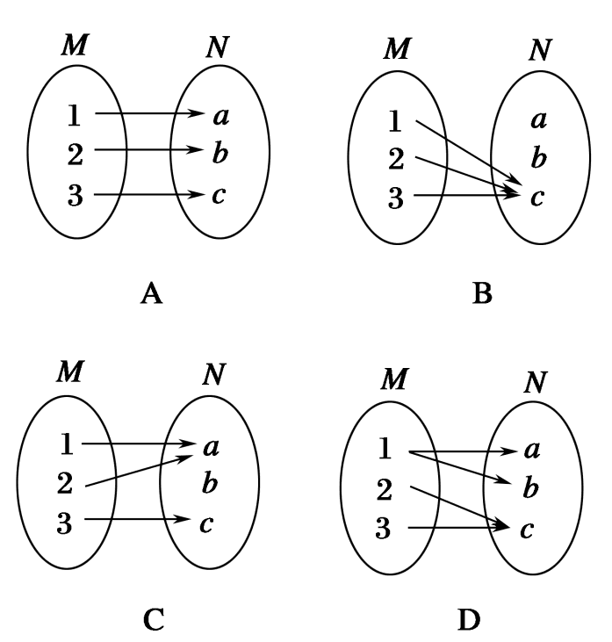
map 映射
1 2 3 4
1 4 9 16
map(pow, [1, 2, 3, 4])

Slide 27
# oj算法题输入 15 20
int a, b;
cin >> a >> b;
a, b = map(int, input().split())
a, b = map(int, ["15", "20"])
a, b = int("15"), int("20")

Slide 28
[1, 2, 3, 4, 5, 6, 7, 8, 9, 1, 5, 9, 7, 5, 6, 6, 3, 4, 1, 8, 5, 4]
list_of_ints = list(map(int, "1234567891597566341854"))
list_of_ints = list(map(int, "13 15 45 84 23 21".split()))

Slide 29
# 转大写 def upper(s): return s.upper() lst = list(map(upper, ['sentence', 'fragment']))
>>> ['SENTENCE', 'FRAGMENT']
lst = list(map(str.upper, ['sentence', 'fragment']))

Slide 30
一种方法
MAP!

Slide 31
from itertools import accumulate a = [1, 2, 3, 4, 5] list(accumulate(a))
[1, 3, 6, 10, 15]

Slide 32
一种标准

Slide 33
filter( )
filterfalse( )
any( )
all( )
min( )
max( )
compress( , )
islice( , )
[::]
dropwhile( , )
takewhile( , )

Slide 34
def f(x): # 是否是3的倍数 if x % 3 == 0: return True else: return False # 写臭了 print(list(filter(f, [1, 6, 89, 345, 12])))
[6, 345, 12]

Slide 35
def f(x): # 是否是3的倍数 return x % 3 == 0 print(list(filter(f, [1, 6, 89, 345, 12])))
[6, 345, 12]

Slide 36
list(filter(lambda x: not x % 3, [1, 6, 89, 345, 12]))

Slide 37
from itertools import filterfalse
print(list(filterfalse(lambda x: not x % 3, [1, 6, 89, 345, 12])))
list(filter(lambda x: x % 3, [1, 6, 89, 345, 12]))

Slide 38
Compress 压缩
compress("ABCDEFG", [True, False, True, False, True, False, True])
>>> ACDE
compress(“ABCDEFG”, [1, 0, 1, 0, 1, 0, 1])

Slide 39
dropwhile 一直抛弃，直到……
dropwhile(lambda x: x < 5, [1, 4, 6, 4, 1])
--> 6 4 1

Slide 40
takewhile 一直保留，直到……
takewhile(lambda x: x < 5, [1, 4, 6, 4, 1])
--> 1 4

Slide 41
islice 切片儿
g = (i for i in range(10)) for n in islice(g, 5): print(n)
0
1
2
3
4
这里只介绍有这个东西，用到再查文档即可

Slide 42
[ ]

Slide 43
chain( )
chain.from_iterable( )

Slide 44
list(chain("abc", "def"))
['a', 'b', 'c', 'd', 'e', 'f']
list(chain("abc", "def", [1, 2, 3]))
['a', 'b', 'c', 'd', 'e', 'f', 1, 2, 3]
list(chain.from_iterable(["abc", "BCD", "QWE"]))
['a', 'b', 'c', 'B', 'C', 'D', 'Q', 'W', 'E']
只能拆一层

Slide 45
( , )
( , )
( , )
( , )
保护组合
远程在后方输出的组合
坚果提供缓冲时间的经典组合
坚果帮助地刺提供输出时间的经典组合

Slide 46
pairwise( )

Slide 47

list(pairwise("ABCDEF"))
[('A', 'B'), ('B', 'C'), ('C', 'D'), ('D', 'E'), ('E', 'F')]

Slide 48
[
]
( , )
( , )
( , )
一种结合方法
[
]

Slide 49
starmap( )

Slide 50
list(starmap(pow, [(2, 5), (3, 2), (10, 3)]))
# [32, 9, 1000]

Slide 51
现在你有 两坨东西

Slide 53
zip( )
zip_longest( )

Slide 54
a = "ABCDEF" b = "123" for item in zip(a, b): print(item)
('A', '1')
('B', '2')
('C', '3')

Slide 55
list(zip_longest("ABCDE", "123", fillvalue="?"))
[('A', '1'), ('B', '2'), ('C', '3'), ('D', '?'), ('E', '?')]

Slide 56
ABCDEFG
abcd
>>> AaBbCcDdEFG

Slide 57
class Solution2: def mergeAlternately(self, word1: str, word2: str) -> str: string = "" i = 0 j = 0 while i < len(word1) and j < len(word2): string += word1[i] i += 1 string += word2[j] j += 1 while i < len(word1): string += word1[i] i += 1 while j < len(word2): string += word2[j] j += 1 return string

Slide 58
class Solution: def mergeAlternately(self, word1: str, word2: str) -> str: ans = [] for x, y in zip_longest(word1, word2): if x: ans.append(x) if y: ans.append(y) return ''.join(ans)
# 来自leetcode 灵茶山艾府

Slide 59
[
]
( , )
( , )
( , )
一种结合方法
[
]

Slide 60
word1 = "abcdefghij" word2 = "134514" from operator import add print("".join(starmap(add, zip_longest(word1, word2, fillvalue=""))))

Slide 62
arr1 = ["高建国", "辣", "莴苣"] arr2 = ["一抹绿", "路障", "蘑菇头"] for body in arr1: for hat in arr2: print(body, "戴着", hat)

Slide 63
from itertools import product arr1 = ["高建国", "辣", "莴苣"] arr2 = ["一抹绿", "路障", "蘑菇头"] for body, hat in product(arr1, arr2): print(body, "戴着", hat)

Slide 64

from itertools import product for x, y, z in product(range(10), repeat=3): setblock((x, y, z), 169)

Slide 65
当然还可以排列，组合……
permutations( )
combinations( )
combinations_with_replacement( )

Slide 66
无穷迭代器
count
cycle
repeat

Slide 67
repeat
for num in [134514] * 50000: print(num)
for num in repeat(134514, 50000): print(num)
for num in chain(repeat(666, 3), repeat(233, 3)): print(num)
for num in repeat(666): print(num) # 无限…

Slide 68
count
for num in count(20, 3): print(num) # 20 23 26 29 ....

Slide 69
count
# [1^2, 2^4, 3^6, 4^8 ...] a = 1 b = 2 while True: print(a ** b) a += 1 b += 2
for a, b in zip(count(1), count(2, 2)): print(a ** b)
for a, b in zip(count(1), count(2, 2)): print(a ** b) if a ** b > 1e9 + 7: break

Slide 70
count
arr = [2, 0, 7, 7, 0, 5, 1, 5] for i, n in enumerate(arr): print(i, n)
arr = [2, 0, 7, 7, 0, 5, 1, 5] for i, n in zip(count(0), arr): print(i, n)
0 2
1 0
2 7
3 7
4 0
5 5
6 1
7 5
arr = [2, 0, 7, 7, 0, 5, 1, 5] for i, n in zip(count(0, 2), arr): print(i, n)
Zip 是合并到短的结束，count是无穷迭代器，所以肯定不会漏

Slide 71
cycle
for num in cycle([1, 2, 3, 1]): print(num) # 1 2 3 1 1 2 3 1...(1=C)
arr = [2, 0, 7, 7, 0, 5, 1, 5] for a, b in zip(arr, cycle([1, -1])): print(a * b) # 正负交替
arr = [2, 0, 7, 7, 0, 5, 1, 5] for a, b in zip(arr, cycle([1, -1, 1, 1, -1])): print(a * b) # 正负正正负

Slide 72



thanks_for_watching()

